Slide 1
Using georeferenced data to enhance land verifications in Financial Audits of the Brazilian Federal District Government
Panel 4
Marcelo Magalhães
Diogo Coelho
TCDF

Slide 2
Reflection
If the only tool you have at your disposal is a hammer, you will tend to see all problems as nails.
Abraham Maslow

Slide 3
Data Science
Panel Topic
Innovation in the public sector
Accounting applied to the public sector
Financial Audit: real estate
Sustainability / Protection of Public Assets

Slide 4
Data Science
Research stream: a more scientific perspective
Develop questions to be answered
Formulate hypotheses/propositions related to the investigation
Choosing and collecting relevant data for analysis
Apply relevant statistical tools to analysis
Results guide the analysis to decide the most plausible hypothesis
Iterative process may involve going back to previous steps
Reference: Prof. Roger Peng/MSDS - UT Austin

Slide 5

Data Science
Example 1: Investigate a Coin Toss (Mechanism)
Hypothesis 1: Fair coin
50% Head
Hypothesis 2: Trick coin
always shows Head
Data collected so far:
1st release gave Head
Reference: Prof. Roger Peng/MSDS - UT Austin

Slide 6
Data Science
Example 1: Investigate a Coin Toss (Mechanism)
For the phenomenon investigated:
Hypothesis 1 (fair currency)
Probability 50%
Hypothesis 2 (trick coin)
Probability 100%
Reference: Prof. Roger Peng/MSDS - UT Austin

Slide 7
Data Science
Example 1: Investigate a Coin Toss (Mechanism)
What if we collect more data?
+ 2 releases:
2nd release: HEAD
3rd release: HEAD
Reference: Prof. Roger Peng/MSDS - UT Austin

Slide 8
Data Science
Example 1: Investigate a Coin Toss (Mechanism)
New odds
H1 (fair coin):
½ * ½ * ½ = 1/8 ou 12,5%
H2 (trick coin):
100%
Was the collection (of more data) informative (relevant to decide on the hypotheses)? YES (helped the analyst decide H1 and H2)
Reference: Prof. Roger Peng/MSDS - UT Austin

Slide 9

Data Science
Example 1: Investigate a Coin Toss (Mechanism)
What if we collected more data?
Your boss suggests:
"Let's weigh the coin"
"Data is always important, that should be useful!"
Reference: Prof. Roger Peng/MSDS - UT Austin

Slide 10
Data Science
Example 1: Investigate a Coin Toss (Mechanism)
Analyst evaluates:
Is there a weight coin difference?
Is skewed currency lighter?
Reference: Prof. Roger Peng/MSDS - UT Austin

Slide 11
Data Science
Example 1: Investigate a Coin Toss (Mechanism)
Scenario 1:
There is no difference in weights
Trick coin and fair currency
They have the same weight
Reference: Prof. Roger Peng/MSDS - UT Austin

Slide 12
Data Science
Example 1: Investigate a Coin Toss (Mechanism)
Scenario 1:
There is no difference in weights
Trick coin and fair currency
They have the same weight
Extra data doesn't help decide
which hypothesis (H1 or H2) is more likely.
The extra data is not informative/relevant!
Reference: Prof. Roger Peng/MSDS - UT Austin

Slide 13
Data Science
Example 1: Investigate a Coin Toss (Mechanism)
Scenario 2:
There is a difference in weights
There is a model
able to assign a weight relation
probability to be fair or trick
Reference: Prof. Roger Peng/MSDS - UT Austin

Slide 14
Data Science
Example 1: Investigate a Coin Toss (Mechanism)
Scenario 2:
There is a model
able to assign a weight relation
probability to be fair or trick
Extra data helps in the decision
promote change in H1 and H2 plausibility
The extra data is informative/relevant!
Reference: Prof. Roger Peng/MSDS - UT Austin

Slide 15
Data Science
Example 2: investigating temperature city São Paulo
Question 1: What is the typical temperature in São Paulo?
Formulate hypotheses:
Hypothesis 1: Temperature is around 30ºC
Hypothesis 2: Temperature is not around 30ºC
Collect data: data from weather centers
Analysis tool: arithmetic mean
Reference: Prof. Roger Peng/MSDS - UT Austin

Slide 16
Data Science
Example 2: investigating temperature city São Paulo
Question 1: What is the typical temperature in São Paulo?
Data collected: annual average temperature is 20ºC
favorable to Hypothesis 2 (temp. is not around 30ºC)
H2 is more plausible than H1
The analysis of hypotheses is always relative
Reference: Prof. Roger Peng/MSDS - UT Austin

Slide 17
Data Science
Example 2: investigating temperature city São Paulo
Question 2: What is the monthly temperature variation in SP?
Formulate hypotheses:
Hypothesis 1: Seasonal variation, warmer in summer
Hypothesis 2: There is no relevant monthly variation (Ex: Equator)
Collect data: data from weather centers
Analysis tool: arithmetic mean?
Reference: Prof. Roger Peng/MSDS - UT Austin

Slide 18
Data Science
Example 2: investigating temperature city São Paulo
Question 2: What is the monthly temperature variation in SP?
Formulate hypotheses:
Hypothesis 1: Seasonal variation, warmer in summer
Hypothesis 2: There is no relevant monthly variation (Ex: Equator)
Collect data: data from weather centers
Analysis tool:
same tool?
arithmetic mean? 20ºC ?
Reference: Prof. Roger Peng/MSDS - UT Austin

Slide 19
Data Science
Example 2: investigating temperature city São Paulo
Question 2: What is the monthly temperature variation in SP?
Analysis tool:
same tool?
arithmetic mean? 20ºC ?
Modify the Analysis Tool
Most pertinent: scatter plot (for example)
Reference: Prof. Roger Peng/MSDS - UT Austin

Slide 20
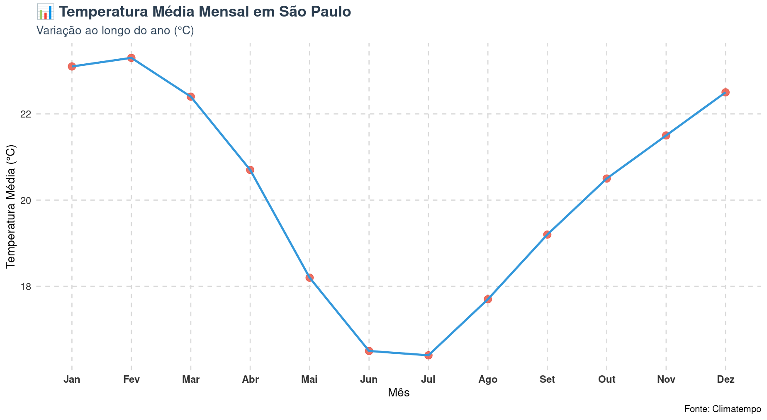
Data Science
Example 2: investigating temperature city São Paulo
Graph prepared by the author (with R)

Slide 21
Data Science
Example 2: investigating temperature city São Paulo
With the new analytics tool:
possible to decide in favor of Hypothesis 1 (there is seasonal variation)
This was not possible with the use of the previous analytics tool
Reference: Prof. Roger Peng/MSDS - UT Austin

Slide 22
Data Science
Depending on the phenomenon investigated (question/hypothesis):
Data collected may or may not be informative/relevant (Ex. 1)
The analytical tool applied to the data collected may or may not be informative/relevant (E.g. 2)
Informative/relevant: ability to affect the analyst's decision on the plausibility of the hypotheses (bring more or less elements to decide for H1 vs. H2 vs. H3)
Reference: Prof. Roger Peng/MSDS - UT Austin

Slide 23
Data Analytics
Data analytics is a set of tools that enable timely analysis and transformation of a heterogeneous data set into structured information suitable for decision-making.
Tang, F., Norman, C. S., & Vendrzyk, V. P. (2017). Exploring perceptions of data analytics in the internal audit function.

Slide 24
Data Analytics
Data analytics is a process by which insights are extracted from data that is internal or external to the organization.
KPMG. (2012). Leveraging data analytics and continuous auditing within internal audit.

Slide 25
Data Analytics
Audit Data Analytics (ADA) is the process of examining datasets that underlie or correlate to the objectives of an audit in order to extract useful information through analysis, modeling, and visualization.
AICPA (2014).
Salvatore, A. (2024). Data analytics in auditing: a practical and managerial approach.

Slide 26
Inspections within the scope of the Federal District Court of Auditors
Financial and Program Audit Division
Operational Audit (performance)
Financial Audit

Slide 27
Management and Resources
Staff
Technical Capacity
Investment in systems
Available databases

Slide 28

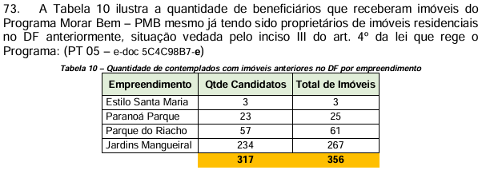
Examples of inspections - Data

Slide 29
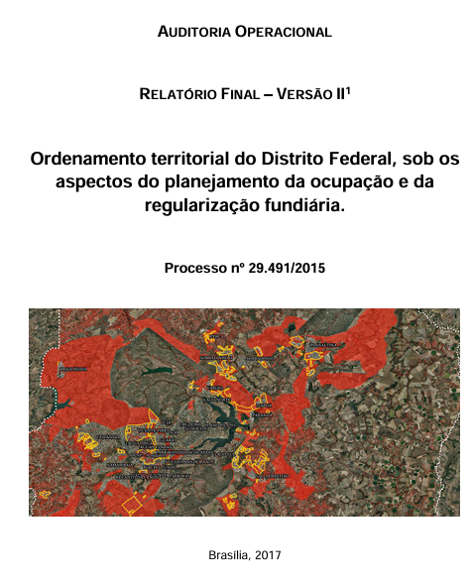
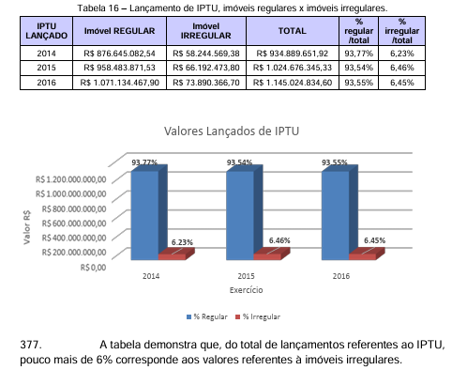
Examples of inspections – Data/sustainability

Slide 30
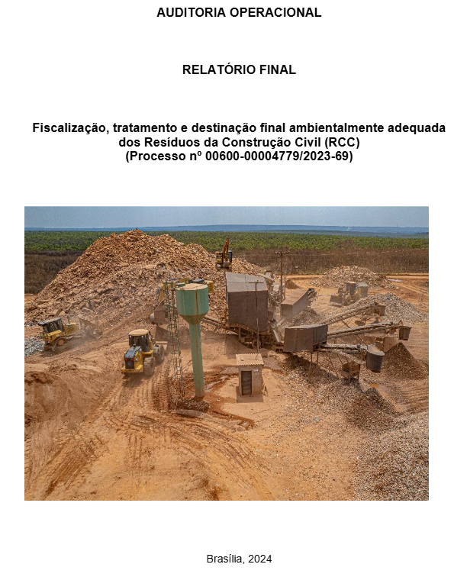
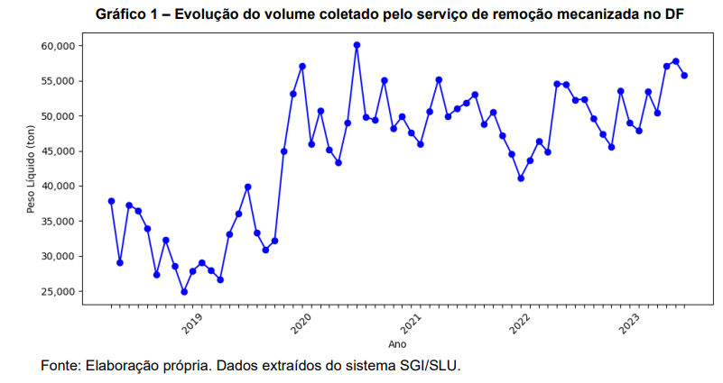
Examples of inspections - Data

Slide 31
Financial Audit
How financial auditing can be an inducer in the search and reception of essential government data to undertake effective inspections.

Slide 32
Case Study - Introduction
Financial Audit – Scoping
Asset verification:
Land (Squares, parks, etc.) and other plots of land
Buildings/Buildings
Goods for Common Use of the People

Slide 33
Case Study - Introduction
Financial Audit – Scoping
What characteristics are directly associated (correlated) with the economic value of an empty lot (without buildings)?
Area (m2)
Location (neighborhood, avenue, zip code, etc.)
Slope plan/existence
Destination of use (what can be built on site)
Etc...

Slide 34
Case Study - Introduction
Financial Audit – Scoping
Impossible to establish an exact economic reference value
Reference value: compare against the accounting value
Approximations/models/analysis tools (Data Analytics)

Slide 35
Case Study - Introduction
Financial Audit – Scoping
What about buildings/buildings?
Age of construction/state of conservation
Carrying out renovation
Architecture
Material/Finish Quality
Destination of use (allowed business)
Etc...
+ Land

Slide 36
Case Study - Introduction
Financial Audit – Scoping
What about buildings/buildings?
Age of construction/state of conservation
Carrying out renovation
Architecture
Material/Finish Quality
Destination of use (allowed business)
Etc...
+ Land
Even more complex analysis
Accounting already has a simpler solution for buildings/buildings: depreciation
And the land part?

Slide 37
Case Study - Introduction
Financial Audit – Scoping
Eliminate the scope only for the terrain cutout
ISA 17 – Fixed Assets:
74. Land and buildings are separable assets and are accounted for separately, even when they are acquired jointly. [...] Buildings have a limited lifespan and are therefore depreciable assets. The increase in value of a land plot on which a building is constructed does not affect the determination of the depreciable amount of the building.

Slide 38
Case Study - Introduction
Financial Audit – Scoping
MCASP:
Due to their characteristics, some items of the asset should not be depreciated. Examples of assets that are not subject to depreciation are land (MCASP, 10 ed., fl. 233).

Slide 39
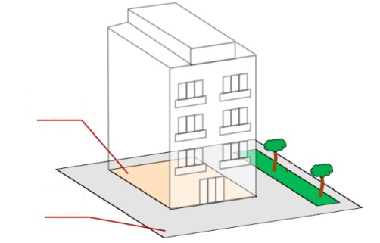
Case Study - Introduction
Financial Audit – Scoping
The scope of this procedure is not to:
For the purpose of this case study, we are not interested in any building/building or structure incorporated into the land
building/
edification
building/building were analyzed by another procedure (analysis of accounting records of depreciation entries)
Scope:
gray projection/
Land Area

Slide 40
Case Study - Introduction
Financial Audit – Scoping
DF Accounting
Buildings/buildings are fully registered as "building", with no entry associated with land
Scope effect of Financial Audit
We ignored the value of the built buildings and checked only the projected portion relative to the land (gray area of the previous figure)

Slide 41
Case Study - Introduction
Financial Audit – Scoping
Verify that the value recorded in the accounting accounts related to land and buildings of the Federal District accounting reflect the reality of their economic value
Limitations
Economic reference value restricted to portion of land (constructions, works and other structures incorporated into the land were ignored)
Need to approximate/model the land's reference value
Analysis restricted to Direct Administration (SisGepat)

Slide 42
Case Study - Getting to know the object
Federal District
Patrimonial System – SisGepat
Real Estate/Movable Property
Accounting is manually fed from SisGepat
Cross-referencing of data between the accounting system (SIGGo) and the equity system (SisGepat)
some specific divergences were identified

Slide 43
Case Study - Getting to know the object
Federal District
Accounting System
Synthetic information
aggregate sum of land/land
Patrimonial System
Analytical information (real estate list)
individual location, m2, notary registration, etc.
Missing data/incomplete information

Slide 44
Case Study - Data Collection
SisGepat Patrimonial System

Slide 45
Case Study - Data Collection
GeoPortal: Georeferencing Data
Aggregate dataset (collect more data)
External and related to the objectives of the audit
Transforming dataset strategy for tools
Enhance the process of visualizing the reality

Slide 46
Data Analytics
Audit Data Analytics (ADA) is the process of examining datasets that underlie or correlate to the objectives of an audit in order to extract useful information through analysis, modeling, and visualization.
AICPA (2014).
Salvatore, A. (2024). Data analytics in auditing: a practical and managerial approach.

Slide 47

Georeferencing

Slide 48
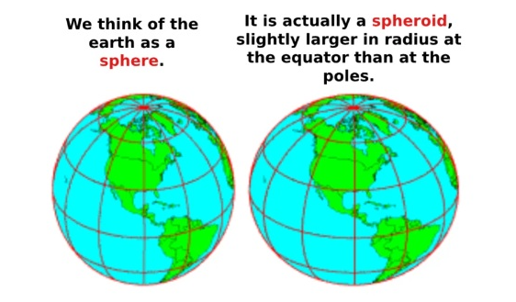
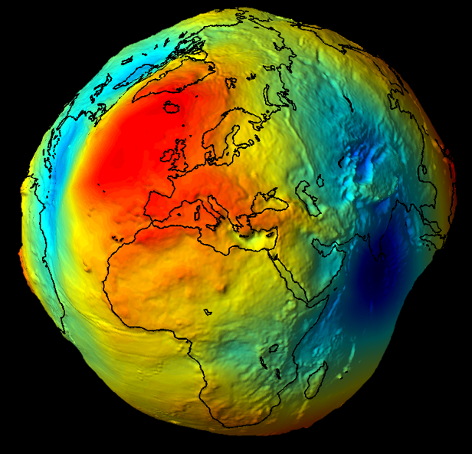
Georeferencing
The actual representation of the Earth's surface is irregular

Slide 49
Georeferencing
Representation systems (Datum)
Local or Global
Location: SIRGAS 2000 (official of Brazil)
The ellipse designed to approximate the surface is adjusted to better accommodate the Brazilian surface, reducing local distortions
Global: WGS 84
The ellipse designed to approximate the surface coincides with the center of the Earth and is the same for all countries, reducing average distortions but increasing local distortions

Slide 50
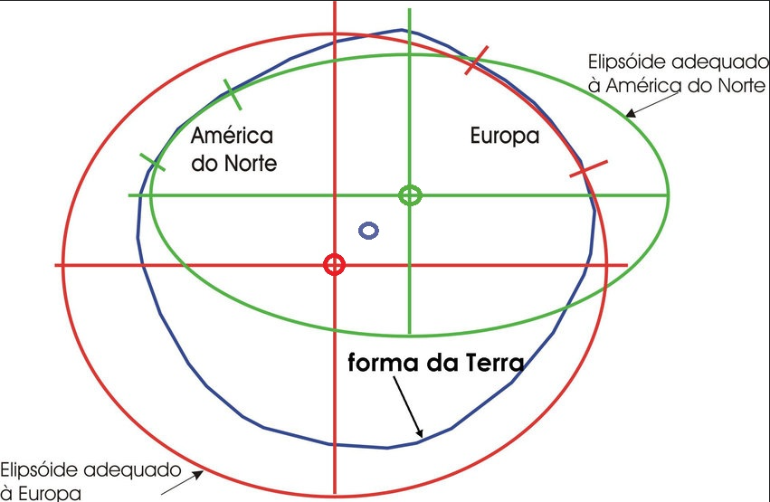
Georeferencing
Example of Local Datums

Slide 51
Georeferencing
TOWPATHS 2000
Geographic Coordinates
Measured in degrees (spherical/non-projected)
Ex: -15.784144º (latitude), -47.906628º (longitude)
UTM (projected in 2D plan)
Measured in meters in system X,Y
Ex: X: 188558.28, Y: 8252777.47

Slide 52
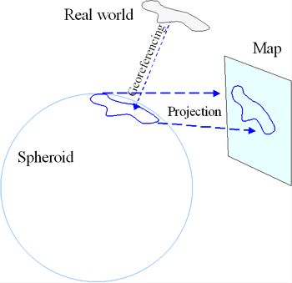

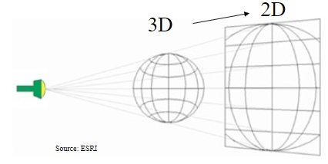
Georeferencing
UTM: Approx. of the terrestrial representation based on projections

Slide 53
Georeferencing
UTM (Universal Transverse Mercator)
Cartesian plane projection
High calculation accuracy for local measurements
Recommended use: Maps and regional measurements (e.g. cartography, Google Maps)

Slide 54
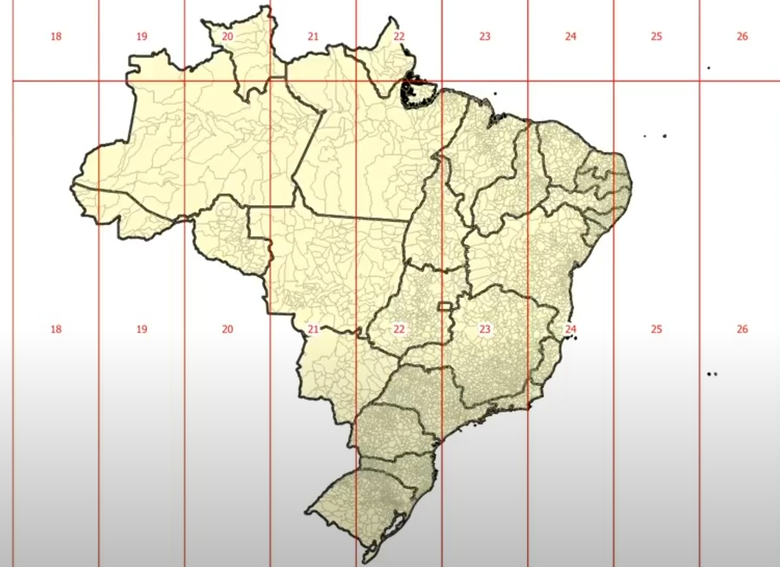
Georeferencing
UTM
DF: Zone 23 South

Slide 55
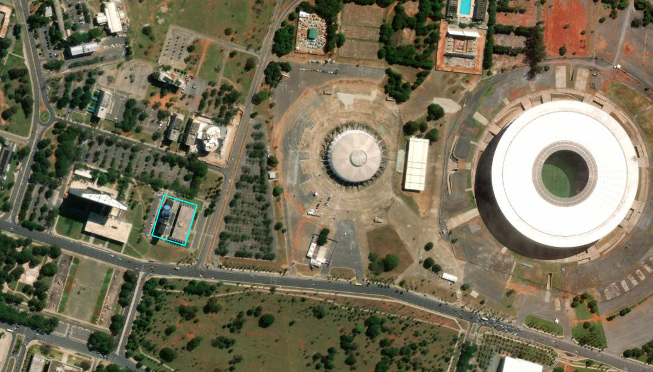
Case Study - Data Analytics
TCDF Sisgepat

Slide 56
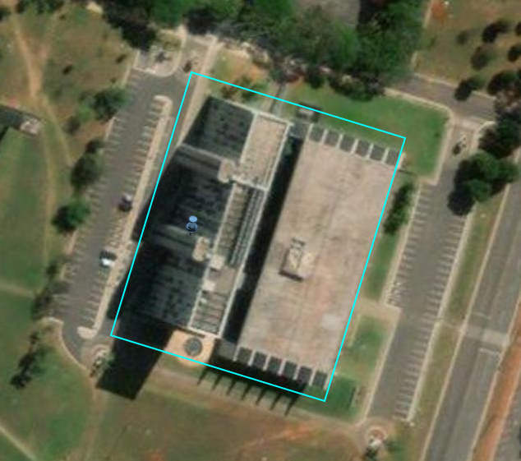
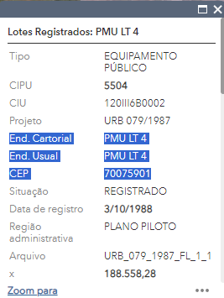
Case Study - Data Analytics
TCDF Sisgepat

Slide 57
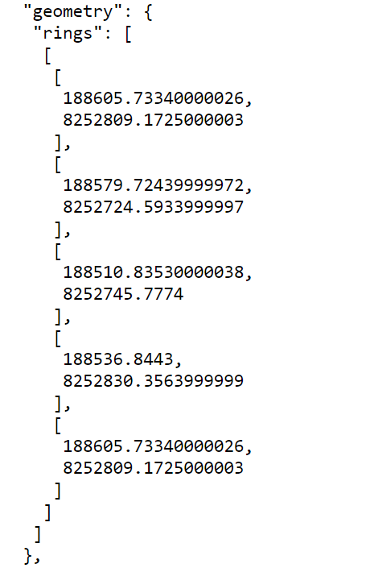
Case Study - Data Analytics
GeoPortal polygon representation
4 points in space in the representation X, Y SIGAR 2000 UTM
Last point returns to the starting point, to close the perimeter of the polygon

Slide 58
Case Study - Data Analytics
Advantages of aggregating information from the GeoPortal
Better quality in the description of the property address
Aggregate information from the zip code, etc.
Plot area information
Enable cross-referencing data with the Revenue database
Verify fiscal value calculation base of the public properties

Slide 59
Case Study - Data Analytics
Would it be possible to perform an automated analysis?
all land registered in SisGepat (census)
It did not prove to be viable
We tried, but many limitations/complexities involved

Slide 60
Case Study - Data Analytics
Limitations on cross-referencing data:
Not all terrains had geometric coordinates
Complex similarity address analysis strategy
Some public lands did not have polygons identified in the GeoPortal
Incompatibility between geometric coordinates recorded in SisGepat and the characteristics of the corresponding polygon
1 plot of land in SisGepat → +1 polygon in GeoPortal
1 polygon in the GeoPortal → +1 land in SisGepat

Slide 61
Case Study - Data Analytics
Limitations due to additional analysis:
Check the area and owner of the land at the notary offices
Visually check for cases of loss of economic value
→ total or partial loss of control of the asset
→ Land invasion

Slide 62
Case Study - Data Analytics
Solution adopted
Sampling

Slide 63
Case Study - Data Analytics
How to select the sample?
Proportional to the monetary value: greater weight of real estate with greater R$
Monetary Unit Sampling (AUM)
ABC Curve
Etc.

Slide 64
Case Study - Data Analytics
How to select the sample?
Hypothesis 1: the economic value of the asset is directly related to the value recorded in the Patrimonial System
Hypothesis 2: the economic value of the asset has no relation to the value recorded in the Patrimonial System

Slide 65
Case Study - Data Analytics
How to select the sample?
Data analysis

Slide 66
Case Study - Data Analytics
How to select the sample?
Data analysis

Slide 67
Case Study - Data Analytics
How to select the sample?
Data analysis

Slide 68
Case Study - Data Analytics
How to select the sample?
Data analysis

Slide 69
Case Study - Data Analytics
How to select the sample?
Data analysis

Slide 70
Case Study - Data Analytics
How to select the sample?
Analysis is favourable to Hypothesis 2
Hypothesis 2: the economic value of the asset has no relation to the value recorded in the Patrimonial System

Slide 71
Case Study - Accounting Standards
Accounting Standards
Measurement after recognition (IPSAS/NBC TSP 17 – Fixed Assets)
Cost Model
Revaluation model
The entity must choose the cost model or revaluation model" (IPSAS/NBC TSP 17 – Fixed Assets)
Is the choice discretionary?

Slide 72
Case Study - Accounting Standards
Accounting Standards
IPSAS 3 – Accounting Policies, Changes in Accounting Estimates and Errors:
An entity shall use its judgement to apply accounting policies that result in information that is:
Relevant to the needs of decision-making users
Reliable
Reflect the economic substance of the transactions
Neutral (free of bias), prudent and complete in all material respects

Slide 73
Case Study - Data Analytics
How to select the sample?
Proportional to the area: greater weight properties of larger area
Area-proportional sampling

Slide 74
Case Study - Data Analytics
How to select the sample?
Hypothesis 1: the area of the property (in m2) is directly related to the area of the property (in m2) registered in the Patrimonial System
Hypothesis 2: the area of the property (in m2) has no relation to the area of the property (in m2) registered in the Patrimonial System

Slide 75
Case Study - Data Analytics
How to select the sample?
Data analysis
Example of registration in SisGepat

Slide 76
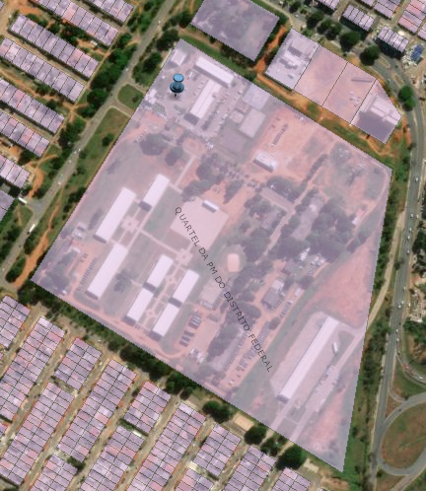
Case Study - Data Analytics
How to select the sample?
Data analysis
GeoPortal Matching Polygon

Slide 77
Case Study - Data Analytics
SisGepat
GeoPortal (matching polygon)
GeoPortal Attribute
(sometimes not filled in)
Geometric calculation, as a function of the projection and size of the polygon in the projected space (always calculable)

Slide 78
Case Study - Data Analytics
How to select the sample?
Conclusion data analysis:
the values of the properties registered in SisGepat cannot be used as a parameter for sample selection
data from the area (m2) and the Administrative Region (RA) are plausible
Control Tests

Slide 79
Case Study - Data Analytics
How to select the sample?
Model relate area and locality (Adm. Region) with economic value
Cooperation with the Department of Economy of Federal District
we request a table of the average value of m2 by Location Region

Slide 80
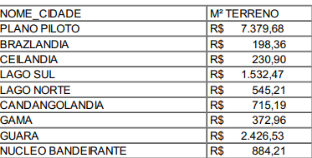
Case Study - Data Analytics
How to select the sample?
Relationship locality (Location Region) and economic value m2

Slide 81
Case Study - Data Analytics
How to select the sample?
Simple linear model
It consists of multiplying the area of the property by the average m2 of the respective region
Able to approximate the economic value of the asset

Slide 82
Case Study - Accounting Standards
Accounting Standard
Revaluation model (IPSAS 17 – Fixed Assets)
46. For some public sector assets, it may be difficult to establish their market value because of the absence of market transactions for these assets.

Slide 83
Case Study - Accounting Standards
Accounting Standard
Revaluation model (IPSAS 17 – Fixed Assets)
47. If no evidence is available to determine the market value […], the fair value of the item may be established by reference to other items with similar characteristics, in similar circumstances and location. For example, the fair value of vacant government land that has been held for a long period during which time there have been few transactions may be estimated by reference to the market value of land with similar features and topography in a similar location […].

Slide 84
Case Study - Data Analytics
Is a sample still needed?
Is it enough to apply the model to the data population and consider the divergences between the results of the model and the accounting as distortion?

Slide 85
Case Study - Data Analytics
Is a sample still needed?
It is not possible to assume that all area and locality records are correct
There may be errors in the area or locality
Additional checks still needed
Confirm area and ownership with notaries
Property invaded
Etc.

Slide 86
Case Study - Data Analytics
Is a sample still needed?
YES!

Slide 87
Case Study - Data Analytics
How to select the sample?
Premise: apply the model to the population of SisGepat properties and create a new monetary value metric for sampling purposes
New column with the monetary value of the property calculated from our model
The new monetary value is related to the economic value of the property (proportional to the value of the m2 and the location) and we can apply a sample proportional to the new monetary value

Slide 88
Case Study - Data Analytics
Stratified Sampling
check whether or not there is a material and material misstatement
Estimate the skew
not possible with other sampling techniques like MUS
MUS: Monetary Unit Sampling

Slide 89
Case Study - Data Analytics
Stratified Sampling
The new monetary value (generated by our model) is divided into statements
random selection of a predefined number of properties in each stratum
In this way, we guarantee that the sample will be representative of the economic value of the goods!

Slide 90
Case Study - Data Analytics
Ferramenta Data Analytics: R
Flexible programming language
Iterative environment/execute parts code/incremental learning
Software emerged in the context of statistics
Free software/large developer community
Simple commands perform complex tasks
Allows the creation of libraries/packages for sharing

Slide 91

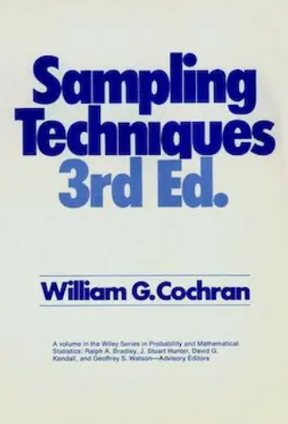
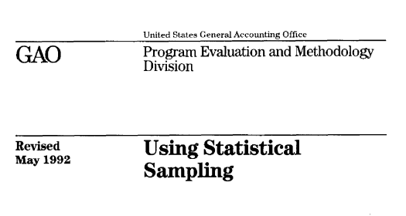
Case Study - Data Analytics
We implement formulas/methodology from classic books
1992
1978
1977

Slide 92
Case Study - Data Analytics
Data Analytics Tool: R – Application for Sampling
We developed an AuditSampling application/package
Available on GitHub (still in development)

Slide 93
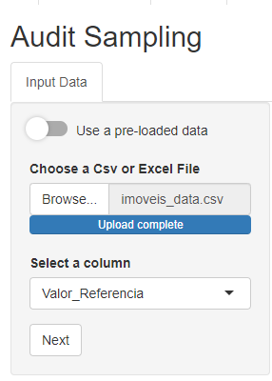
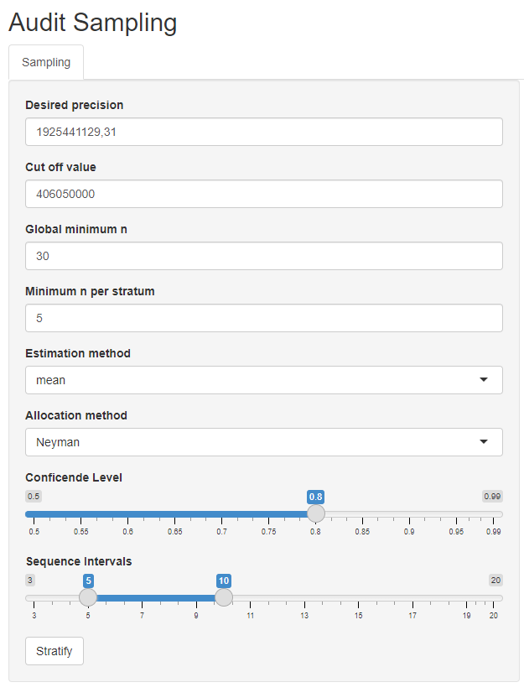
Case Study - Data Analytics
Data Analytics Tool: R – Application for Sampling

Slide 94
Case Study - Data Analytics
Data Analytics Tool: R – Application for Sampling

Slide 95
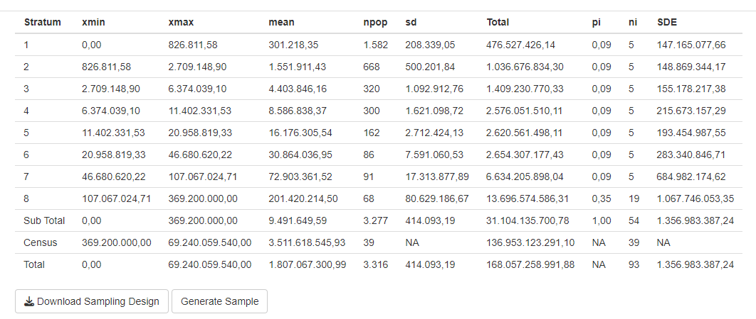
Case Study - Data Analytics
Data Analytics Tool: R – Application for Sampling
94

Slide 96

Case Study - Data Analytics
Data Analytics Tool: R - Georeferencing
GeoPortal georeferenced database
Simple Features Library ("sf") → georeferencing
Polygon match in coordinates
Identify the corresponding Location Region
Check the project area and polygon area
We have added columns of information to the SisGepat columns

Slide 97
Case Study - Data Analytics
Data Analytics Tool: R - Georeferencing
SF package has commands to easily convert the geometric points from one system to another (just enter the EPSG code)

Slide 98
Case Study - Data Analytics
Challenge
Land visualisation
→ GeoPortal's last satellite image is from 2021
Solution
we use the points of the polygons and design them in Google API
updated image from 2024/2025

Slide 99
Case Study - Data Analytics
Results
We identified 91 polygons out of the total of 94 in the sample
We request validation from the Secretariat of Development Urban and Housing (SEDUH)
Possible to add useful information (visualisation) such as attribute level (area, address, region with greater reliability)
Evidence helped in the decision process (whether or not the accounts reflected their respective economic value) and also in the estimation of the distortion

Slide 100
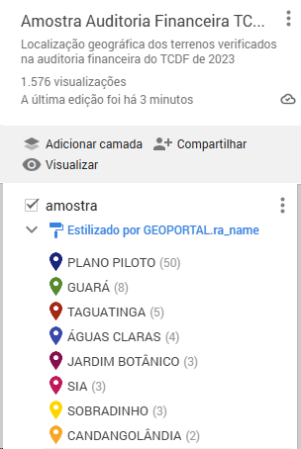
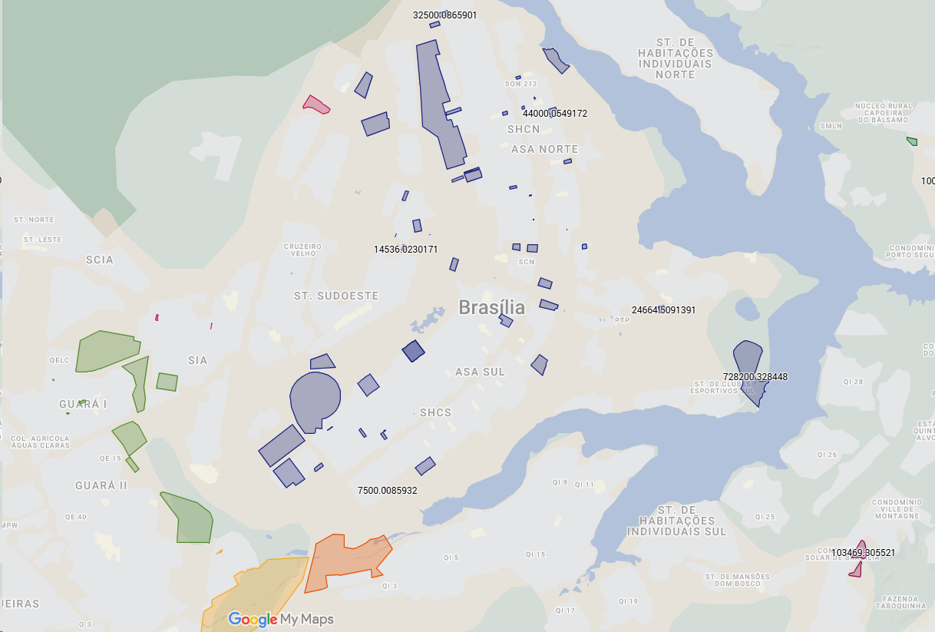
Case Study - Results
Results
https://www.google.com/maps/d/viewer?mid=14NaxdmT4M-EnGPX5BNxCeM3vryamXvI&ll=-15.827926110323265%2C-47.95957400000001&z=11

Slide 101
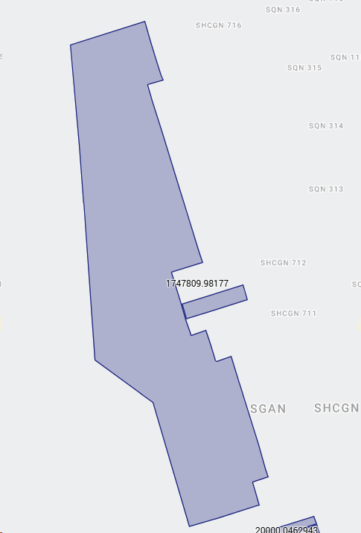
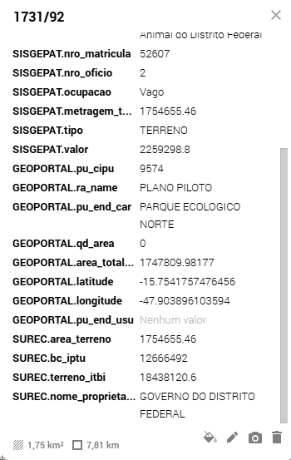
Case Study - Results
Results
https://www.google.com/maps/d/viewer?mid=14NaxdmT4M-EnGPX5BNxCeM3vryamXvI&ll=-15.827926110323265%2C-47.95957400000001&z=11

Slide 102
Case Study - Results
Results
Financial Audit Photo Attachment
Accessed at:
https://www2.tc.df.gov.br/consultas-e-servicos/consultas/
Case: 00600-00013919/2023-90-e
Audit Report (part 84)
Photographic Attachment: ATTACHMENT N°. II/2024 DIAFI (part 86)

Slide 103
Case Study - Results
Results
The set of 94 properties in the sample represented a total area of 75.6 million m2 (7,560 hectares)
Accounting/Estate System
total value: about R$ 422 million
approximately R$ 5.50 per m2
lag in the real value of the properties

Slide 104
Case Study - Results
Results
75.6 million m2 (7,560 hectares)
→ only 1 property almost 60%: 45.2 million m2 (4,520 hectares)
There was no polygon drawn for this property in the GeoPortal
Amount posted in accounting:
→ 10 million R$ (less than R$ 0.25 per m2 or U$S 0.04)

Slide 105
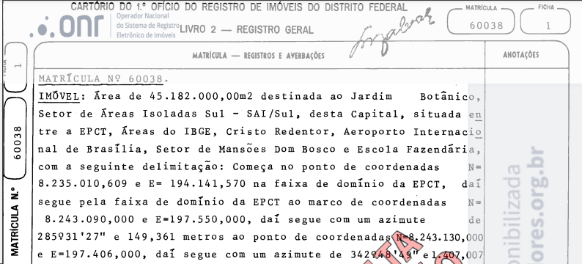
Case Study - Sustainability
Vast amount of land identified

Slide 106
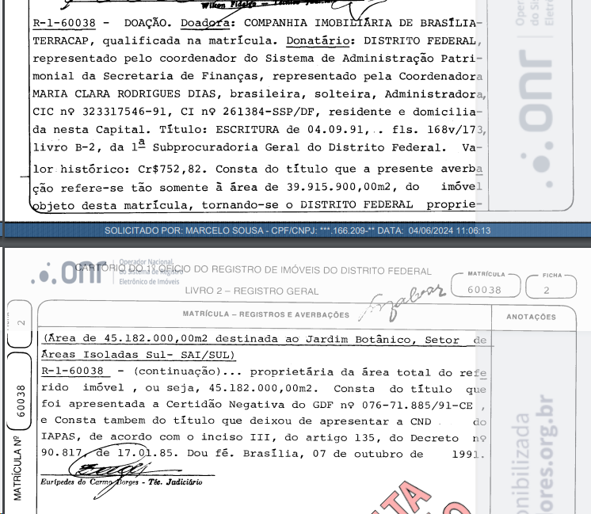
Case Study - Sustainability
4,520 hectares
28 Ibirapuera Parks
+ 6,000 football fields

Slide 107
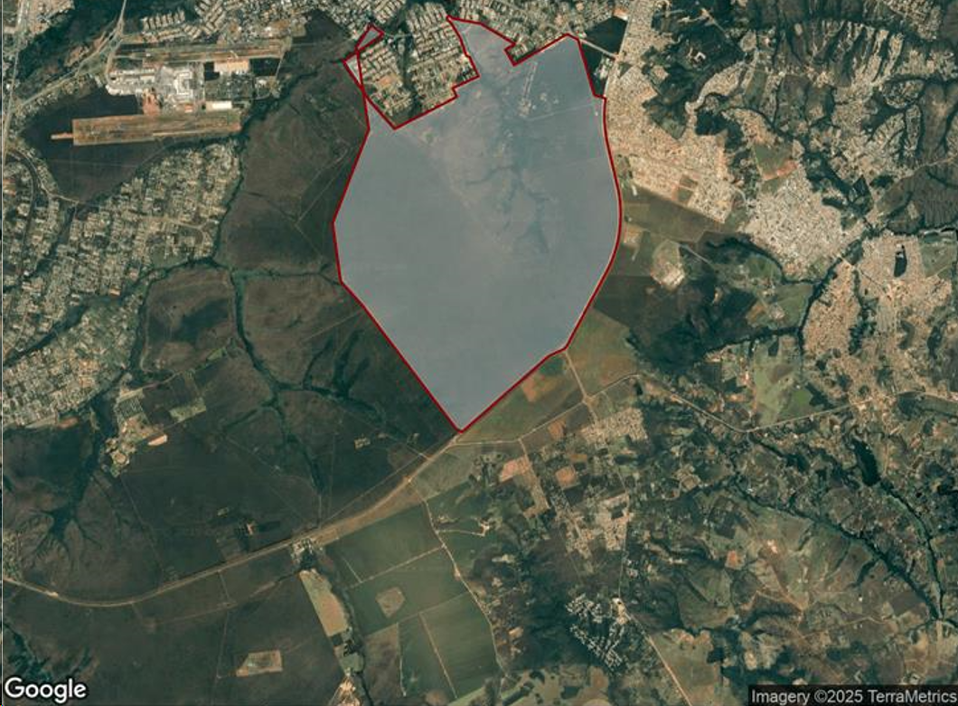
Case Study - Sustainability
Vast amount of land identified

Slide 108
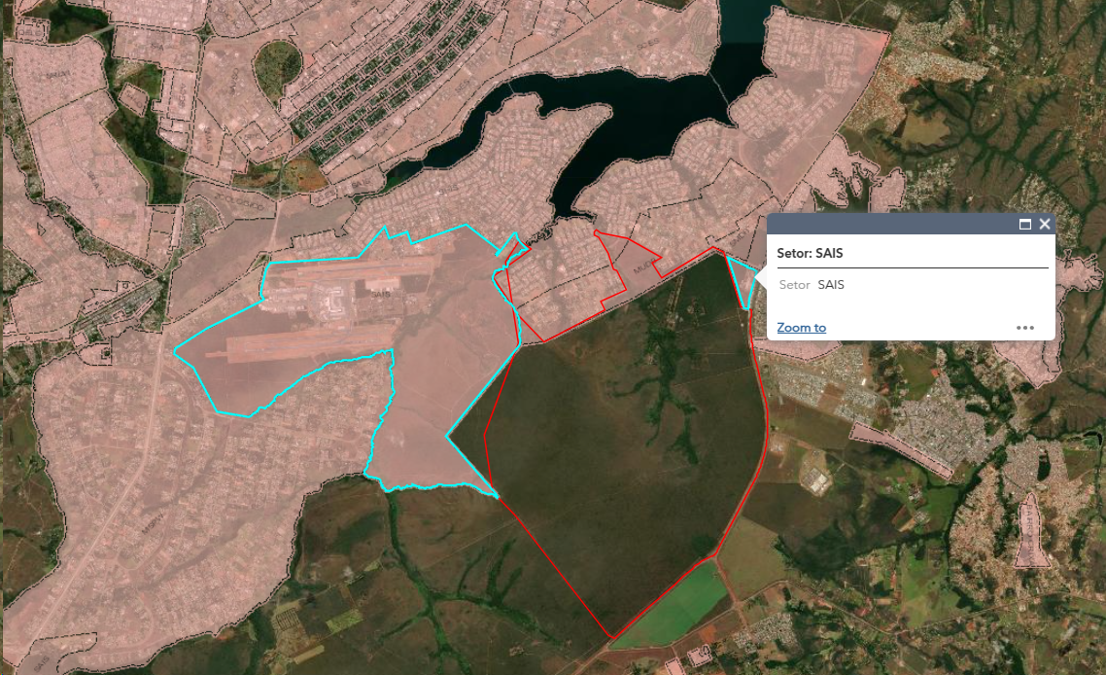
Case Study - Sustainability
Vast amount of land identified
There is no polygon created in the GeoPortal for this piece of land
I elaborated this polygon (sketch) and projected it on the GeoPortal

Slide 109
Case Study - Reflections
Transparency/trustworthiness/sustainability
Property registered at 10 million in accounting is practically "hidden" (it does not gain the prominence it deserved)
Property is also not being tracked by Seduh/GeoPortal
How to preserve/protect public properties in this context?

Slide 110
Reflections
Context
On the one hand, the public sector has a series of agencies that promote environmental sustainability (such as IBAMA, MAPA, FUNAI, etc.) with excellent business mastery and use of advanced technologies. On the other hand, accounting is still seen as an isolated sector whose information produced is rarely taken into account in decision-making and in the implementation of public policies (managers still prefer to ask the business areas)
Questioning
How could accounting improve the reliability of accounting records through the use of technologies and knowledge sharing with the various business areas of the Public Sector? How to bring the business area and accounting closer together/integrate?

Slide 111
Reflections
Context
The case study demonstrated that relevant public areas that should be subject to public policies of preservation, custody and protection do not gain prominence in accounting. Even the most attentive citizen would not be able to understand the patrimonial wealth of the State, only with the cold analysis of the numbers, often underestimated.
Questioning
Who is non-informative accounting for? How should accounting move to improve transparency and better highlight the social wealth managed by the State in the numbers presented in its balance sheets?
f

Slide 112
Reflections
Questioning
How could public accounting serve as a stimulus to civil society engagement in the preservation of public heritage, especially areas of permanent preservation, avoiding environmental degradation, land invasions and climate change?
D
Dd
D
D
d

Slide 113
Contact
Marcelo Magalhães Silva de Sousa
External Control Auditor – Court of Auditors of the Federal District
marcelomsousa@tc.df.gov.br
PPT, materials, R applications used, codes, etc. Available at:
https://github.com/marcelosousa-utexas/CIGAR2025
Diogo dos Santos Coelho
External Control Auditor – Court of Auditors of the Federal District
diogo.coelho@tc.df.gov.br

